Slide 1
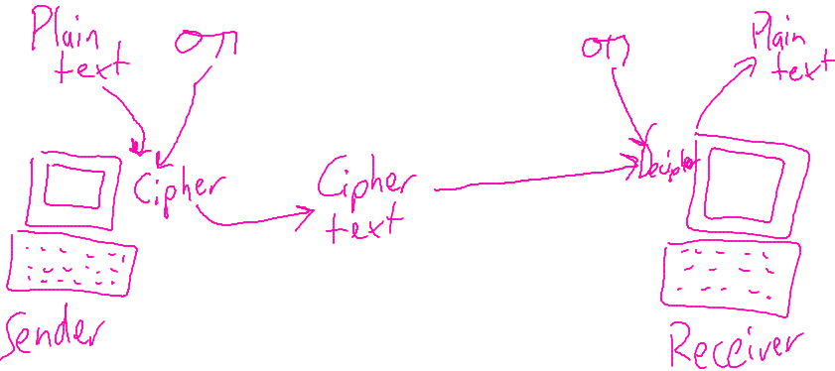
Encryption notes to make
Key words:
Encrypt
Decrypt/decipher
Cipher
Key
Plain text
Cipher text
Overall how it works – explain the diagram
Why would people use encryption

